Slide 1
NETWORK TRAFFIC ANALYSIS USING MACHINE LEARNING
PRESENTED BY
VIJAYASRI JUNNU 21S11A05C6
KEERTHANA JUMBARATH 21S11A0583
VARSHINI VASAM 21S11A05C3
SANDEEP KAMSALI 21S11A05A3
Under the Guidance of
K.SANDHYA
B.TECH , M.TECH
Asst.Professor

Slide 2

NETWORK TRAFFIC ANALYSIS
USING MACHINE LEARNING
This Photo by Unknown Author is licensed under CC BY-NC-ND

Slide 3
ABSTRACT
In the world of networking, it sometimes becomes essential to know what types of applications flow through the network for performance of certain tasks. Network traffic classification sees its main usage among ISPs to analyze the characteristics required to design the network and hence affects the overall performance of a network. For an implementation of Machine learning algorithm, python sklearn library is used with NumPy and Pandas library used as helper libraries. Finally, we observe that K nearest algorithm gives more accurate prediction than Naïve Bayes Algorithm, Decision Tree Algorithm and Support Vector Machine.

Slide 4
EXISTING SYSTEM
Machine learning (ML) has revolutionized network traffic analysis by enhancing security and efficiency. It enables anomaly detection to spot unusual traffic patterns, predictive maintenance to prevent downtime, and traffic classification to optimize resource allocation. ML also improves security threat detection by identifying and responding to threats like malware and DDoS attacks in real time, while performance optimization ensures smooth operations by addressing bottlenecks and optimizing configurations. These capabilities support adaptive network management, fostering dynamic adjustments for greater efficiency, security, and reliability.

Slide 5
Continued..
DISADVANTAGES
Complex Models: Require significant resources and expertise.
High False Positives: Normal behavior can be misclassified as anomalous.
Feature Engineering Complexity: Requires domain knowledge and understanding.
Data Privacy Concerns: Handling sensitive information raises privacy issues.
Risk of Overfitting: Models may not generalize well to new data.

Slide 6
PROPOSED SYSTEM
The proposed network traffic analysis system includes network sensors, a centralized data repository, an analysis engine, a visualization and reporting interface, and an alerting system. It collects and processes data for real-time and historical analysis, featuring packet capture, flow analysis, deep packet inspection, anomaly detection, and performance monitoring. Utilizing tools like Wireshark, Zeek, Elasticsearch, and TensorFlow, the implementation plan ensures scalability, performance, security, and compliance. This system provides comprehensive monitoring, effective threat detection, and insightful reporting to enhance network security and performance.

Slide 7
ADVANTAGES
Continued..
1. High Accuracy in Protocol Classification:
- Utilizing machine learning algorithms like Naïve Bayes, K-Nearest Neighbors, Decision Trees, and SVM can lead to accurate classification of network protocols, improving overall security and operational efficiency.
2. Anomaly Detection:
- These algorithms excel in identifying anomalies and potential security threats within network traffic, such as unusual patterns or suspicious activities, enabling proactive security measures.
3. Resource Optimization:
- Efficient traffic classification and analysis help in optimizing resource allocation, prioritizing critical applications, and enhancing overall network performance and efficiency.
4. Real-Time Analysis and Monitoring:
- The system operates in real-time, continuously monitoring network traffic for immediate detection of issues, ensuring timely responses and mitigations.

Slide 8
SYSTEM REQUIREMENTS
SOFTWARE REQUIREMENTS:
Operating system : Windows 11.
Coding language : Python.
Version : 3.7.1.
Libraries : Numpy, Tensorflow, Seaborn, Pandas, Scikit-learn, Open-CV.
HARDWARE REQUIEMENTS:
System : Intel Core i5 or equivalent.
Hard Disk : 500 GB.
RAM : 16 GB.

Slide 9
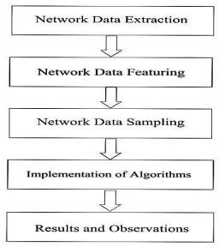
SYSTEM ARCHITECTURE
Fig. 1: process of classification of Network Traffic.

Slide 10
MODULES
Data Collection
Data Preprocessing
Feature Engineering
Machine Learning Models

Slide 11
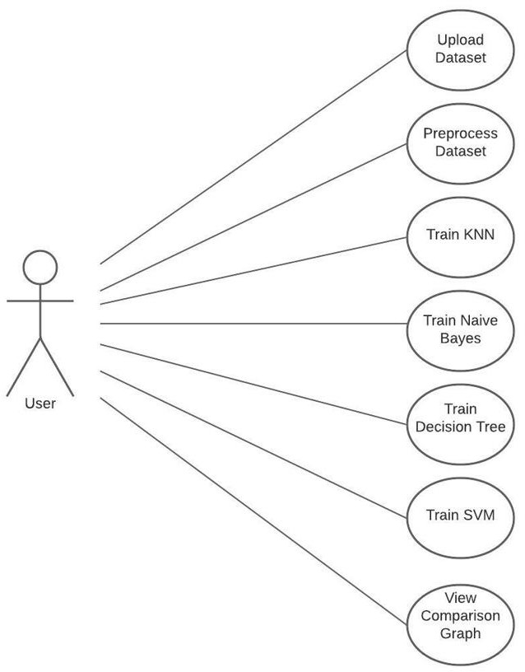
UML DIAGRAMS
Fig: Use case Diagram

Slide 12
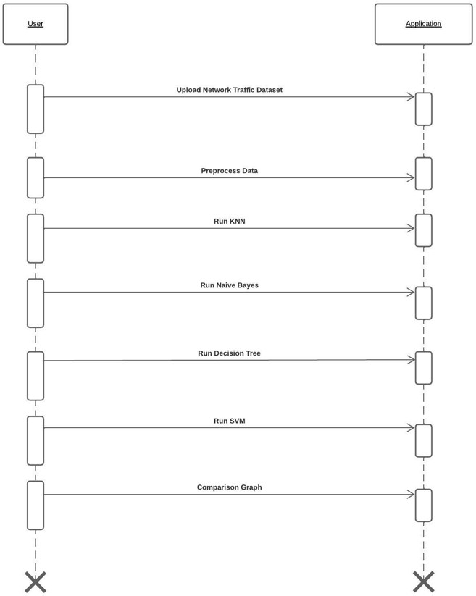
Fig: Sequence Diagram

Slide 13
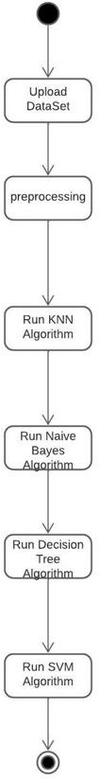
Fig: Activity Diagram

Slide 14
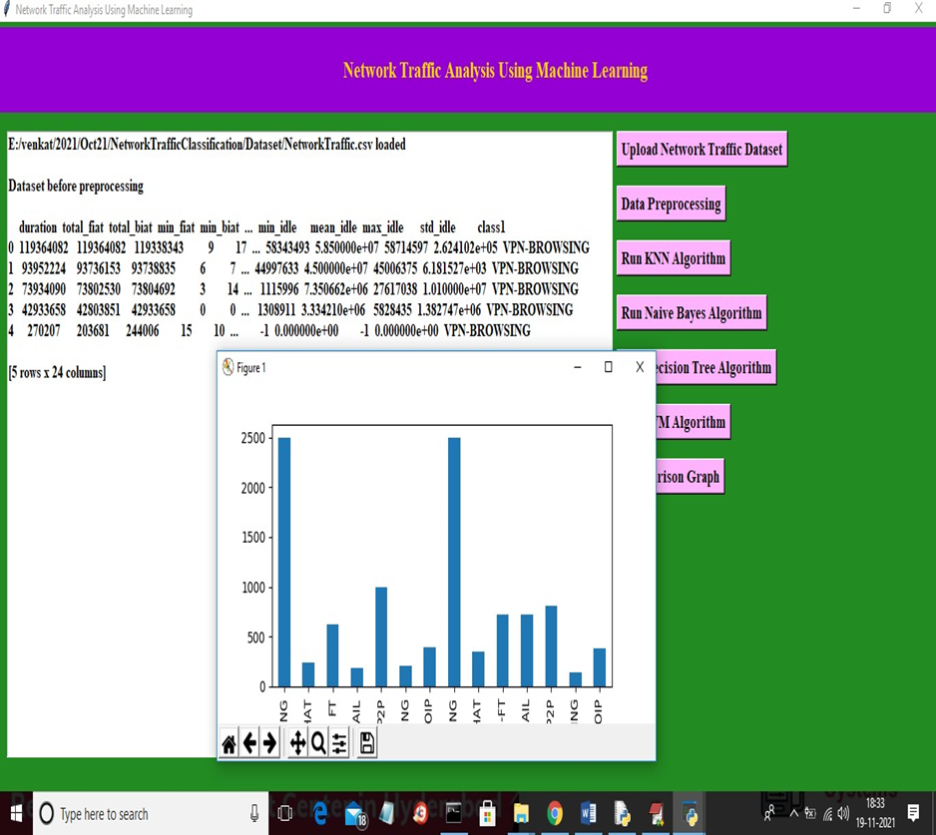
OUTPUT SCREEN

Slide 15
CONCLUSION
The Network traffic classification techniques are discussed in this paper to enhance some idea about Machine Learning algorithms for network traffic data. The analysis carried out definitely helps to a new analyst to make the decision about which Machine Learning algorithm is more appropriate for this application. Further, the classifiers using different Machine Learning algorithms are developed to compare the accuracy for this network traffic data. We find that K-nearest neighbor (KNN) algorithm outperforms Naïve Bayes algorithm, Decision Tree and Support Vector Techniques in terms of accuracy which is due to the fact that KNN uses better classification criterion than Naïve Bayes and Decision Tree Algorithm. We find that KNN is most robust among the algorithms: NB, DT, and SVM for out training data set. It is also able to maintain highest mean for accuracy.

Slide 16

THANK YOU

